Slide 1
Chapter 3
Chapters
1. Introduction
2. Graphs
3. Descriptive statistics
4. Basic probability
5. Discrete distributions
6. Continuous distributions
7. Central limit theorem
8. Estimation
9. Hypothesis testing
10. Two-sample tests
13. Linear regression
14. Multivariate regression
Numerical Descriptive Techniques I

Slide 2
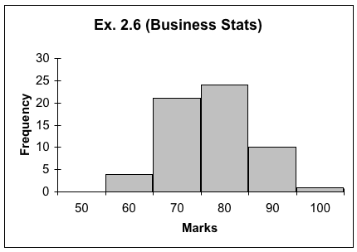
Introduction…
Recall Lecture 2, where we used graphical techniques to describe data:
While this histogram provides some new insight, other interesting questions (e.g. what is the class average? what is the mark spread?) go unanswered.

Slide 3
Numerical Descriptive Techniques…
Measures of Central Location/Central Tendency
Mean, Median, Mode
Measures of Variability/Dispersion
Range, Standard Deviation, Variance, Coefficient of Variation
Measures of Relative Standing
Percentiles, Quartiles
Measures of Linear Relationship
Covariance, Correlation, Least Squares Line

Slide 4
Measures of Central Location…
The arithmetic mean, a.k.a. average, shortened to mean, is the most popular & useful measure of central location.
It is computed by simply adding up all the observations and dividing by the total number of observations:
Sum of the observations
Number of observations
Mean =

Slide 5


Notation…
When referring to the number of observations in a population, we use uppercase letter N
When referring to the number of observations in a sample, we use lower case letter n
The arithmetic mean for a population is denoted with Greek letter “mu”: Parameter or Statistic?
The arithmetic mean for a sample is denoted with an “x-bar”: Parameter or Statistic?

Slide 6
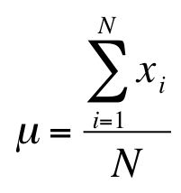
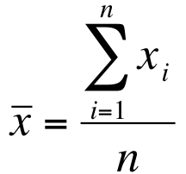
Statistics is a pattern language…
 | Population | Sample
Size | N | n
Mean

Slide 7
Median
The median is calculated by placing all the observations in order; the observation that falls in the middle is the median.
Data: {0, 7, 12, 5, 14, 8, 0, 9, 22} N=9 (odd)
Sort them bottom to top, find the middle:
0 0 5 7 8 9 12 14 22
Data: {0, 7, 12, 5, 14, 8, 0, 9, 22, 33} N=10 (even)
Sort them bottom to top, the middle is the
simple average between 8 & 9:
0 0 5 7 8 9 12 14 22 33
median = (8+9)÷2 = 8.5
Sample and population medians are computed the same way.

Slide 8
Measures of Central Location…
The mode of a set of observations is the value that occurs most frequently.
A set of data may have one mode (or modal class), or two, or more modes.
Mode is a useful for all data types, though mainly used for nominal data.
For large data sets the modal class is much more relevant than a single-value mode.
Sample and population modes are computed the same way.

Slide 9
Mode…
E.g. Data: {0, 7, 12, 5, 14, 8, 0, 9, 22, 33} N=10
Which observation appears most often?
The mode for this data set is 0. How is this a measure of “central” location?
A modal class
Frequency
Variable

Slide 10
Mean, Median, Mode…
If a distribution is symmetrical,
the mean, median and mode may coincide…
median
mode
mean

Slide 11

Mean, Median, Mode…
If a distribution is asymmetrical, say skewed to the left or to the right, the three measures may differ. E.g.:
median
mode
mean

Slide 12
For Interval Data
If data are symmetric, the mean, median, and mode will be approximately the same.
If data are skewed, or have outliers, report the MEDIAN.
Mean is very sensitive to extreme values called “outliers”.
If data are multimodal, report the mean, median and/or mode for each subgroup.

Slide 13
Examples
As soon as a billionaire moves into a neighborhood, the average household income increases beyond what it was previously!
Imagine if NBA player Yao were in this class, what happens to the mean height and median height of the class.

Slide 14
Incomes in a Neighborhood
X={20,000; 40,000; 60,000; 80,000}
Mean = 50,000
Median = 50,000
Now a Millionaire moves into the neighborhood
X={20,000; 40,000; 60,000; 80,000;1,000,000}
Mean = huge number
Median = 60,000

Slide 15
Mean, Median, Mode: Which Is Best?
With three measures from which to choose, which one should we use?
The mean is generally our first selection. However, there are several circumstances when the median is better.
The mode is seldom the best measure of central location.
One advantage the median holds is that it is not as sensitive to extreme values as is the mean.

Slide 16
Mean, Median, Mode: Which Is Best?
To illustrate, consider the data in Example 4.1.
The mean was 11.0 and the median was 8.5.
Now suppose that the respondent who reported 33 hours actually reported 133 hours (obviously an Internet addict). The mean becomes :

Slide 17
Mean, Median, Mode: Which Is Best?
This value is exceeded by only two of the ten observations in the sample, making this statistic a poor measure of central location.
The median stays the same.
When there is a relatively small number of extreme observations (either very small or very large, but not both), the median usually produces a better measure of the center of the data.

Slide 18
For Ordinal & Nominal Data
For ordinal and nominal data the calculation of the mean is NOT valid.
Median is appropriate for ordinal data.
For nominal data, a mode calculation is useful for determining highest frequency but not “central location”.

Slide 19
Measures of Central Location: Summary…
Compute the Mean to
Describe the central location of a single set of interval data
Compute the Median to
Describe the central location of a single set of interval or ordinal data
Compute the Mode to
Describe a single set of nominal data

Slide 20
? Measure of Central Location

Slide 21
? Measure of Central Location

Slide 22
Weighted Mean
W_{i}=Weight of Observation i.
Grades (Xi) | # of Grades (Wi) | WiXi
A=4 | 4 | 4*4=16
B=3 | 7 | 7*3=21
C=2 | 3 | 3*2=6
D=1 | 1 | 1*1=1
 |  | GPA=44/15=2.93

Slide 23
Grouped Data
Median Class is the class with the n/2 entry
Modal Class is the class with the largest frequency.
Costs $ | Frequency fi | Mi (Midpoint) | Mi*fi | Cumulative fi
0-100 | 10 | 100/2=50 | 500 | 10
100-200 | 18 | 150 | 2700 | 28
200-300 | 60 | 250 | 15000 | 88
300-400 | 70 | 350 | 24500 | 158
400-500 | 42 | 450 | 18900 | 200
 |  |  |  | Median Class is 300-400. Modal class is 300-400.

Slide 24
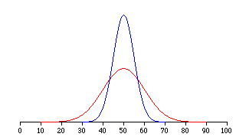
Measures of Variability…
Measures of central location fail to tell the whole story about the distribution; that is, how much are the observations spread out around the mean value?
For example, two sets of class grades are shown. The mean (=50) is the same in each case…
But, variability are not the same. The red class has greater variability than the blue class.

Slide 25
Range…
The range is the simplest measure of variability, calculated as:
Range = Largest observation – Smallest observation
E.g.
Data: {4, 4, 4, 4, 50} Range = 46
Data: {4, 8, 15, 24, 39, 50} Range = 46
The range is the same in both cases,
but the data sets have very different distributions…

Slide 26
Range…
Its major advantage is the ease with which it can be computed.
Its major shortcoming is its failure to provide information on the dispersion of the observations between the two end points.
Moreover, range is sensitive to extreme values, just like the mean.
Inter Quartile Range (IQR) is one common solution.
Hence we need a measure of variability that incorporates all the data and not just two observations. Hence…

Slide 27


Variance…
Variance and its related measure, standard deviation, are arguably the most important statistics.
Used to measure variability, they also play a vital role in almost all statistical inference procedures.
Population variance is denoted by
(Lower case Greek letter “sigma” squared)
Sample variance is denoted by
(Lower case “S” squared)

Slide 28


Variance…
The difference between one obs. and the mean is called Deviation of the obs.
The variance of a population is:
The variance of a sample is:
population mean
sample mean
population size
Note! the denominator is sample size (n) minus one !

Slide 29
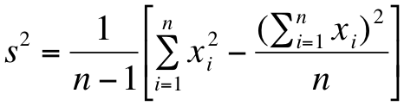
Variance…
As you can see, you have to calculate the sample mean (x-bar) in order to calculate the sample variance.
Alternatively, there is a short-cut formulation to calculate sample variance directly from the data without the intermediate step of calculating the mean. Its given by:

Slide 30
Variance…
Why is sample variance different from population variance?
A sample does not include all the information of a population.
Samples tend to UNDER estimate the population variability.
If we divide by (n-1) instead of n, we get a slightly larger number.
(n-1) is called the degree of freedom of the sample.

Slide 31
Application…
Example 4.7. The following sample consists of the number of jobs six students applied for: 17, 15, 23, 7, 9, 13.
Finds its mean and variance.
What are we looking to calculate?
The following sample consists of the number of jobs six students applied for: 17, 15, 23, 7, 9, 13.
Finds its mean and variance.
…as opposed to μ or σ²

Slide 32



Sample Mean & Variance…
Sample Mean
Sample Variance
Sample Variance (shortcut method)

Slide 33


Standard Deviation…
The standard deviation is simply the square root of the variance, thus:
Population standard deviation:
Sample standard deviation:

Slide 34
Standard Deviation…
It is not easier to calculate – you have to get a variance first.
It is easier to interpret than variance.
It is measured in the same unit as the data is measured.

Slide 35
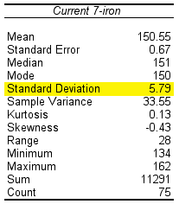
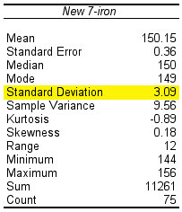
Standard Deviation…
Consider Example 4.8 where a golf club manufacturer has designed a new club and wants to determine if it is hit more consistently (i.e. with less variability) than with an old club.
Using Tools > Data Analysis… > Descriptive Statistics in Excel, we produce the following tables for interpretation…
You get more consistent distance with the new club.

